Slide 1
Rex the Recycling Robot
2019 YWIAI - Team C

Slide 2


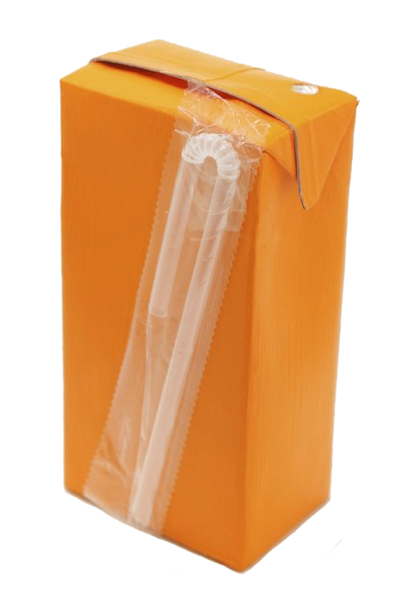
Do you know how to correctly dispose of this popper?
Plastic wrapping & glue

Slide 3
“Queensland is one of the worst performing states in recycling and waste management”
The Honourable Leanne Enoch, Minister for Environment and the Great Barrier Reef, Minister for Science and Minister for Arts, 2019

Slide 4
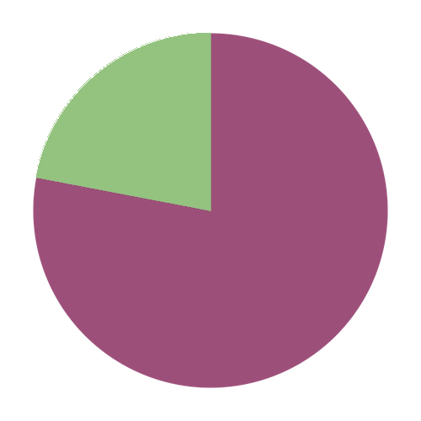

In Queensland schools
78%
45kg
of school
waste could
be converted to recycling and composting
of waste is produced per student per year
1. recyclenow.com 2. sustainabilityinschools.edu.au
Notes:
If we do not change our recycling practices, we would be swimming in our own rubbish.
QLD tourism industry and main economic driver for our state. Therefore, less money coming into the economy
Increase cost and pressure on waste infrastructure
Increase health issues from ground contamination

Slide 5
How do we improve our waste and recycling behaviours to protect our environment for generations to come?

Slide 6
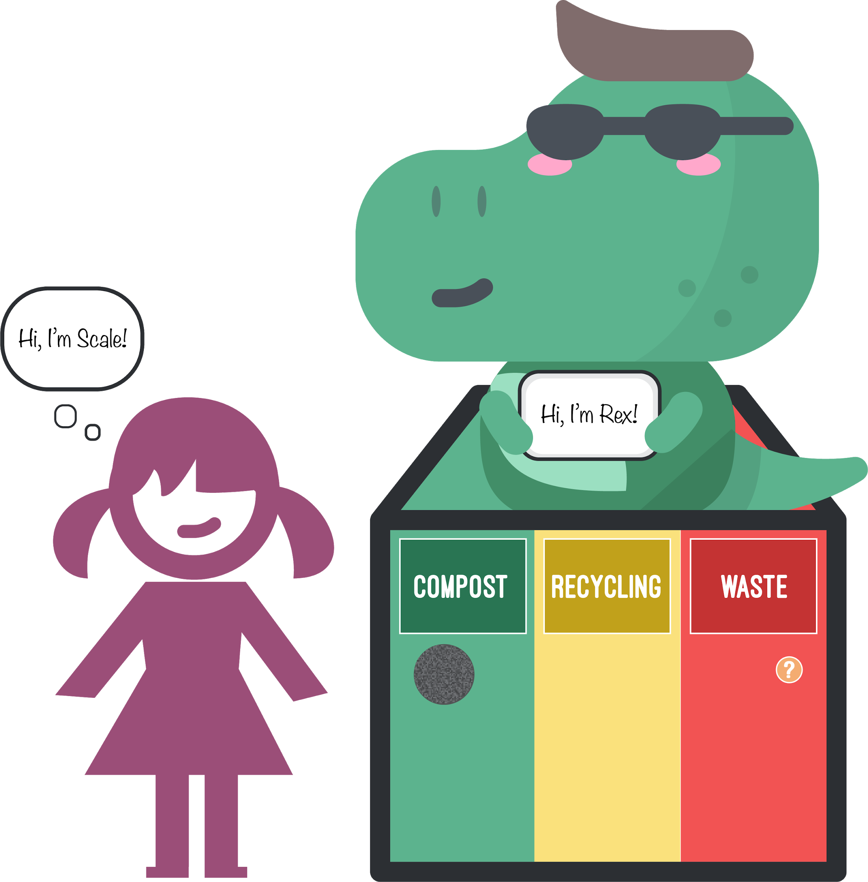
Rex the Recycling Robot
Meet Rex!
Rex will visit primary school students to teach them how to recycle and compost
Notes:
Robo-Rex will be a roaming educational installation that will visit schools and provide opportunities for students to practice their recycling behaviours in a fun, interactive competition against other schools
School vs school
Highest scoring school wins
Earn points by putting rubbish in the correct category
Kids will have fun with a hands-on activity
Educate kids on the effects of not recycling, teach them how to recycle and encourage them to recycle

Slide 7
Rex the Recycling Robot

Slide 8
Rex the Recycling Robot

Slide 9
Leveraging AI Technology
WHY AI?
Computer vision & deep learning to classify rubbish.
Dataset of 180 images of poppers and chips with 90:15 training: test ratio.
WHY TRUST OUR AI?
>85% accuracy
Next steps: increase image dataset size to improve accuracy.

Slide 10
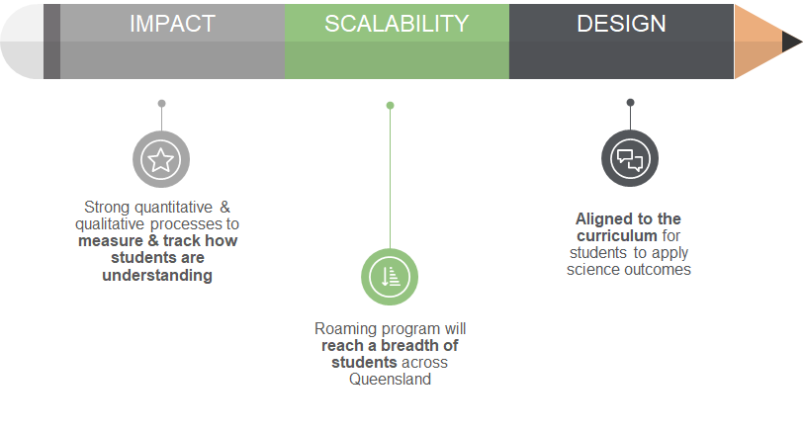
Perfect Partnership
RoboRex meets QLD Department of Education’s Quality Assurance Assessment Tool for STEM initiatives in state schools

Slide 11
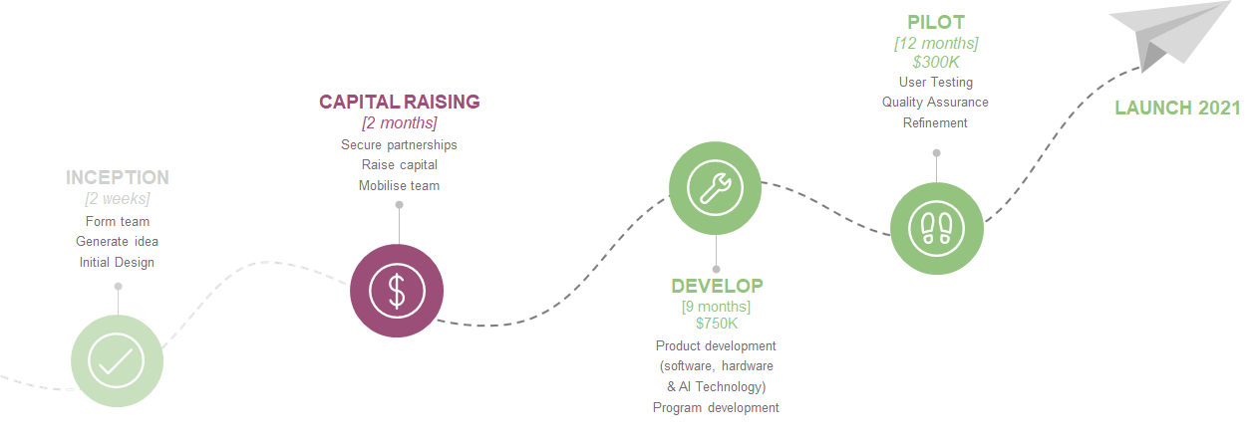
WHERE WE ARE HEADED NEXT

Slide 12
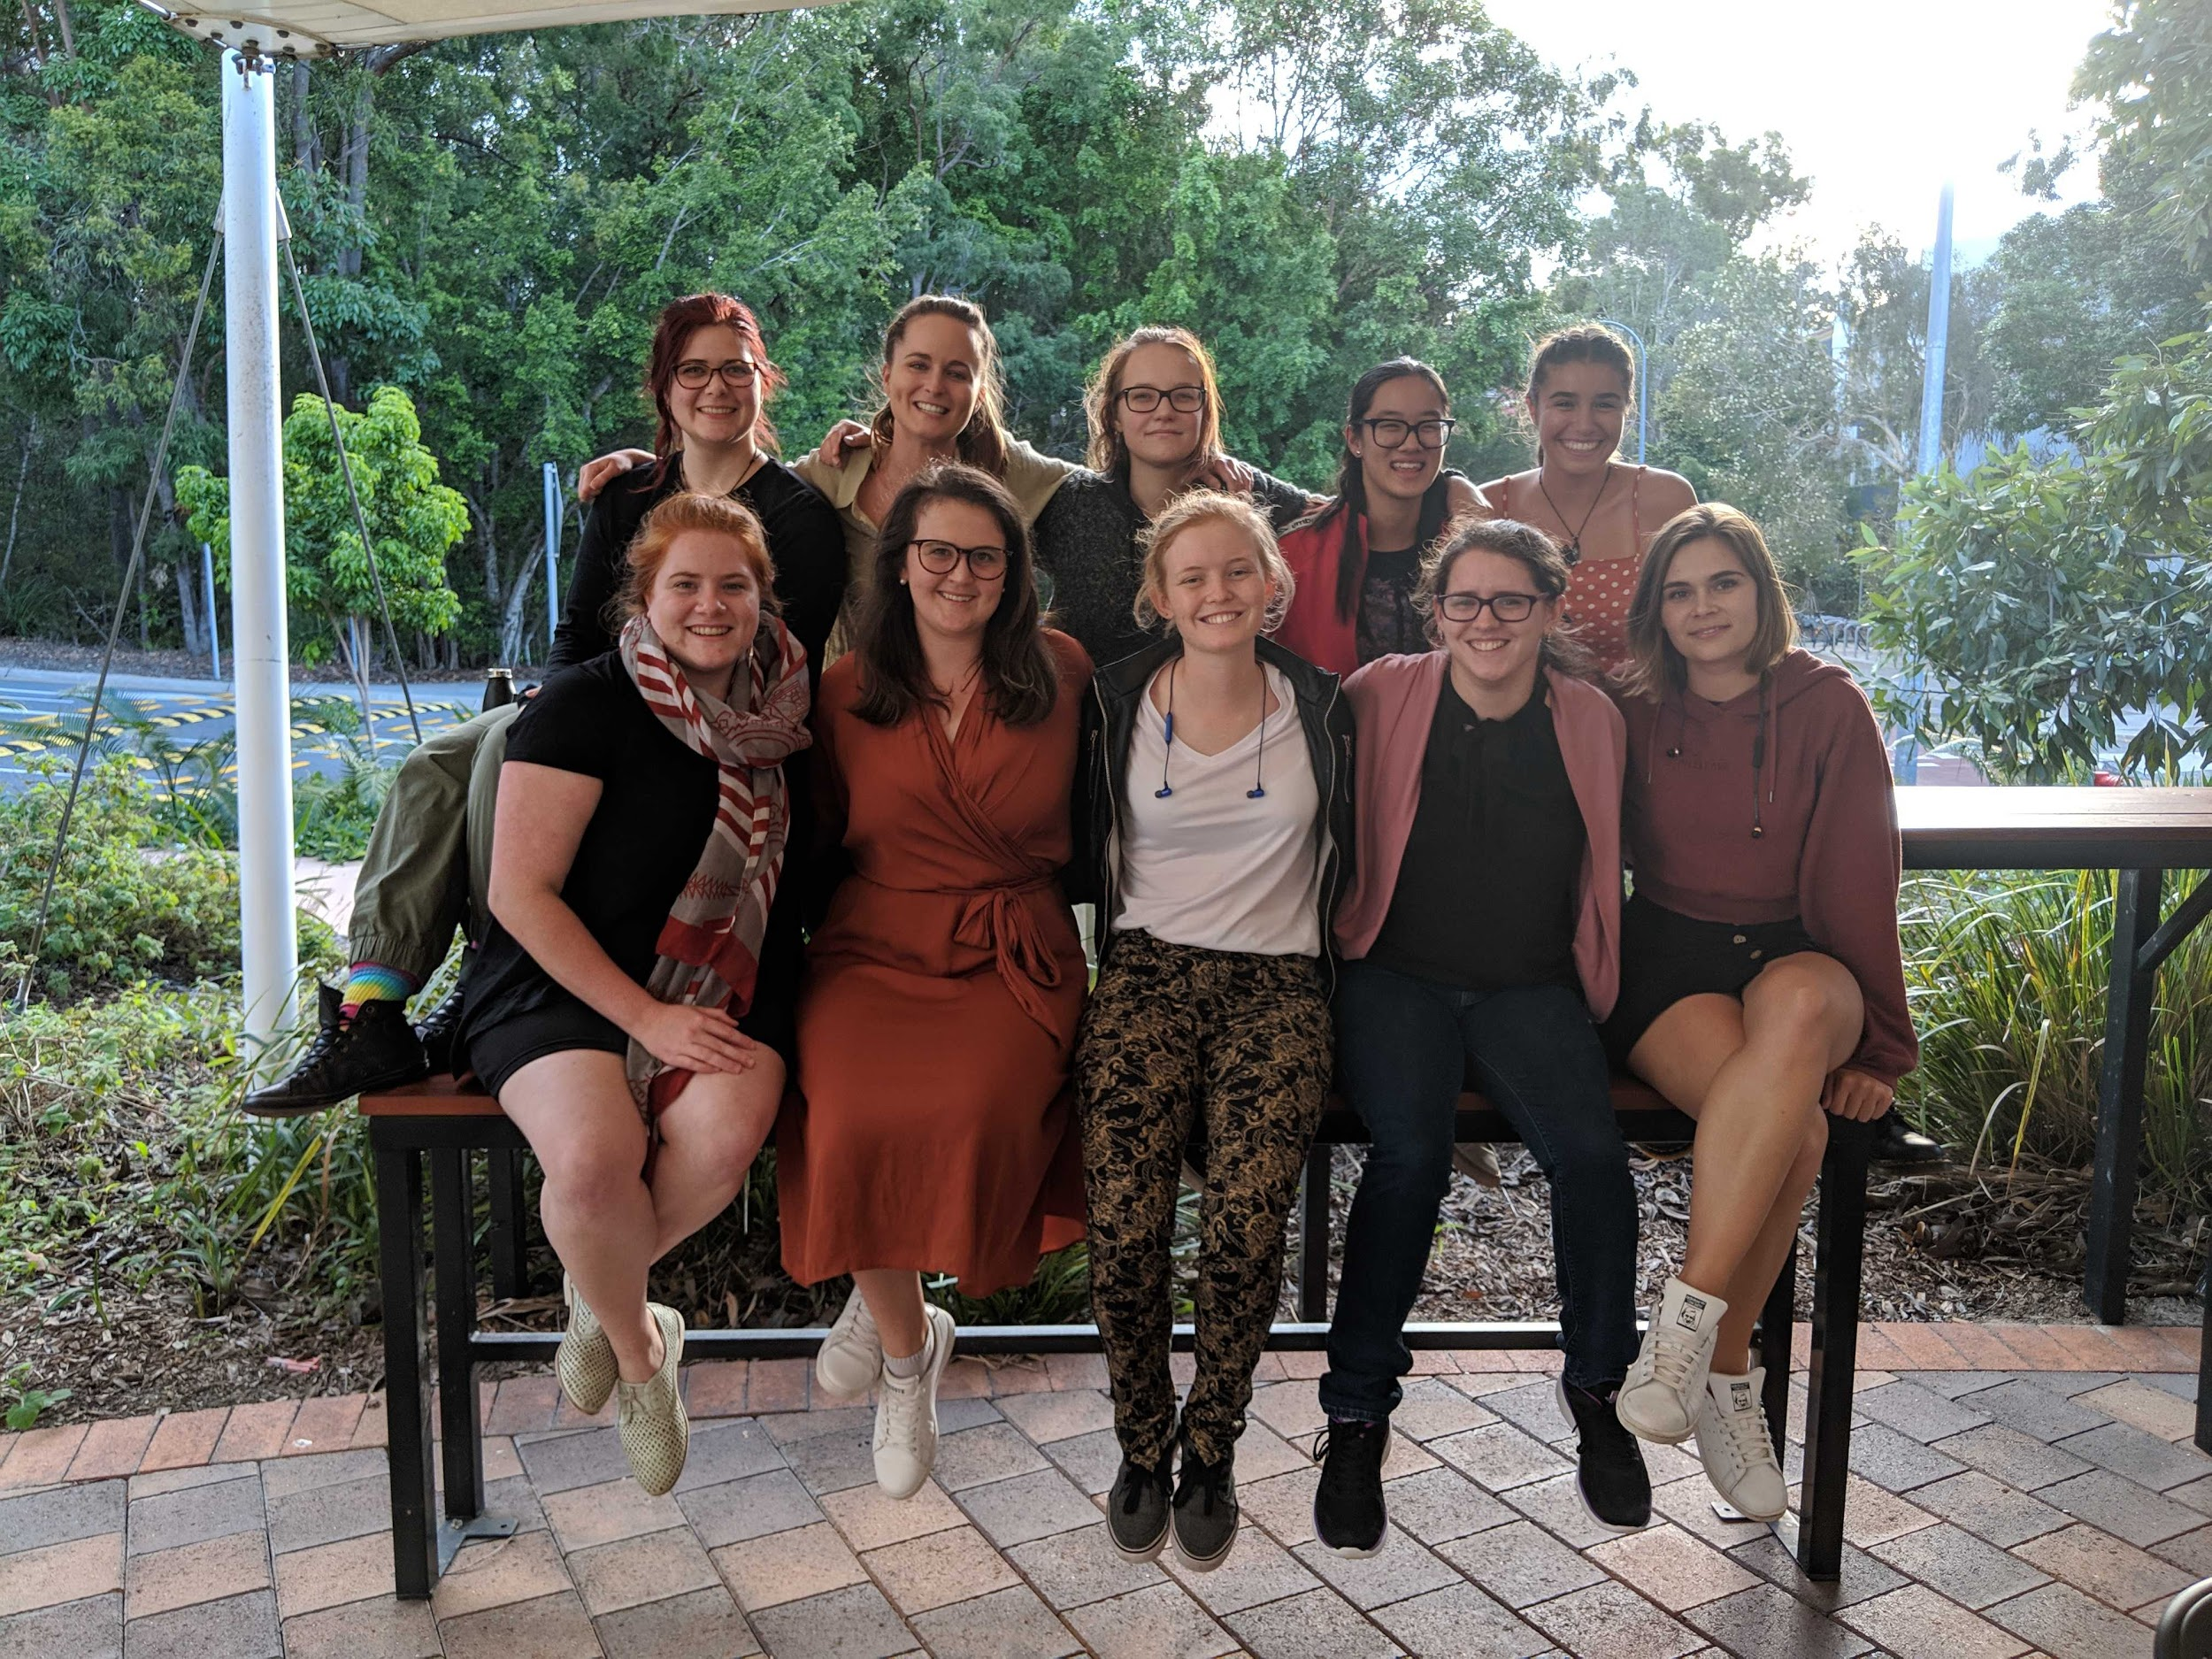
Meet the team
We are a team of engineers, marketers and designers.

Slide 13
Help us to inspire the next generation to improve our waste and recycling behaviours

Slide 14
Rex the Recycling Robot
recyclewithrex.com

Slide 15
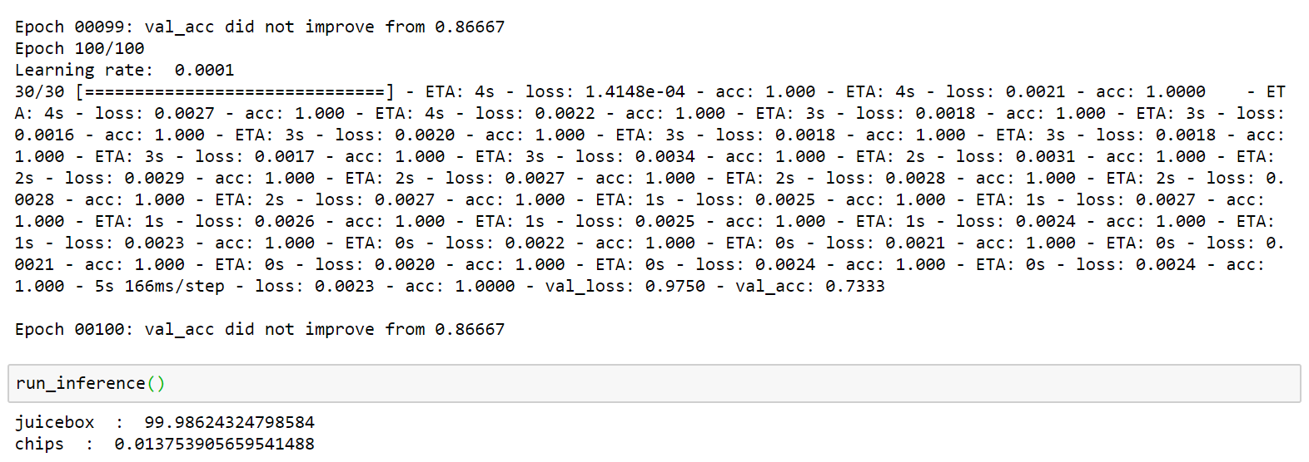
Leveraging AI Technology
The last iteration of the train:test algorithm
>85% accuracy during testing and 99% accurate at interference

Slide 16
APPENDIX - ETHICS
Jackie & Ash
BENEFIT TO HUMANITY
Educating the next generation, helping the environment and indirectly teaching parents and staff too
HUMAN BIAS
AI EVALUATION
AI ADVANTAGES
STAKEHOLDERS
- Images of trash from the internet.
- Learn from students unidentified trash.
- Streamlined recycling at the source
- Type of school (public vs private)
- For teachers, do they believe what the bins do
- Schools
- Queensland Government
- Students
- Teachers
- Parents
- Recycling companies
- Researchers
METRICS
ACCESS
- number of items recycled/ not recycled
- points system
- Government
- Schools
- Local recycling centres
- Local councils
RISKS & UNINTENDED CONSEQUENCES
MITIGATION
- Children and schools privacy
- Safety; arms in bin
- Negative impacts of gamification
- Appropriate rubbish being disposed
- Control system
- Safety feedback loops
- Lux design of system
- Lucid vs gamification

Slide 17
Department of Education Quality Assurance Tool
Impact
Design
Service: interactive robotic device allows students an enhanced educational experience
Outcome: Students become more knowledgeable and are able to recycle
Measured through a strong metrics system and an ethics aspect is considered
Purpose: educating younger generations and raising awareness about recycling
Rex suits the school’s context as it is aim for primary school students
Scalability
Effect: reduction of waste and increase of recycling rates
Long term factors: expanding nationally and potentially globally
Potential consequences: different learning system that the robot needs to adapt to

Slide 18
Department of Education Quality Assurance Tool
Investment
Physical resources: transportation of the rubbish
Human resources: researchers, testers, software/hardware engineer
Other Factors
Rural vs metro
State vs public schools
Culture and ethnicity

Slide 19
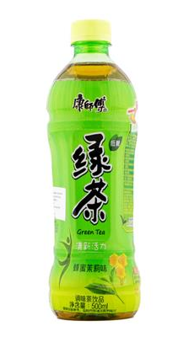
Key Considerations
Consideration | Mitigation Actions
Bias | Cultural Data inclusive of products of different cultures
 | Rural vs Metro / Private schools vs State schools Ensuring equal accessibility to the program
Unintended items in bin | Ensuring there is no accidental disposal of personal items such as phones through allowing an easy way to retrieve those items Train AI to recognise such items Teachers supervising how children use the bin
Data privacy | Not using the AI to collect facial recognition data of students Data on the eating habits of students may be collected this way and proper management of this data is required
Hannah & Darya

